Slide 1

Fastory Filtrerer
Yunus Emre Akgün
21726875

Slide 2
Contents
01
02
03
04
Purpose
Implementation
Algorithm
What is the purpose of
Fastory Filtrerer
How we implemented our
idea to Webgl2.
What algorithm we used and
How we implemented it
05
06
Camera and Shading
Models
References
Different camera and diffrent shading implementation
Wh,ch Models and whivh objects used

Slide 3
01
Purpose of Project

Slide 4
Fastory Filtrer is a 3D game that you can enjoy with it.The Fastory filterer game will help you to gain you to environmental awareness about air pollution.Everyday so many factory ,house and many buildings emit toxic gas into the environment.This game suggest to use filter of every factory and buildings and other altarnative solutions to this problem.
Climate change affects everything from geopolitics to economies to migration. It shapes cities, life expectancies and wine lists. And because it touches everything The Economist reports on, we examine it from every angle imaginable we have to protect our nature.

Slide 5
02
Implementation

Slide 6
Which techologies used in this project?
Three. JS : is a cross-browser JavaScript library/API which is used to create and animate 3D computer graphics to display in a web browser. It's one type of a single JavaScript file and includes features like effects, scenes, cameras, lights, sky, materials, meshes, shaders, animations, and 3D objects.
To implement proect firstly I used Three.js which is javascript framework it easy and useful
Blender is the free and open source 3D creation suite. It supports the entirety of the 3D pipeline—modeling, rigging, animation, simulation, rendering, compositing and motion tracking, even video editing and game creation. Advanced users employ Blender’s API for Python scripting to customize the application and write specialized tools; often these are included in Blender’s future releases. Blender is well suited to individuals and small studios who benefit from its unified pipeline and responsive development process.To create our maps and blender used.

Slide 7
Shadings
To apply different shadings, I created a fragment and vertex shader. In these shaders we used uniform variable to create different lightnings.user can swich whatever he wants using «ş» key

Slide 8
Shaders-1
Vertex Shader 1
varying vec3 vWorldPosition;
void main() { vec4 worldPosition = modelMatrix * vec4( position, 1.0 );
vWorldPosition = worldPosition.xyz; gl_Position = projectionMatrix * modelViewMatrix * vec4( position, 1.0 ); }
Fragment Shader 1
uniform vec3 topColor;
uniform vec3 bottomColor;
uniform float offset;
uniform float exponent;
varying vec3 vWorldPosition;
void main() { float h = normalize( vWorldPosition + offset ).y;
gl_FragColor = vec4( mix( bottomColor, topColor, max( pow( max( h , 0.0), exponent ), 0.0 ) ), 1.0 );
}

Slide 9
Shaders-2
Vertex Shader
varying vec2 vUv;
void main()
{
vUv = uv;
vec4 mvPosition = modelViewMatrix * vec4( position, 1.0 );
gl_Position = projectionMatrix * mvPosition;
}
Fragment Shader
uniform float time; varying vec2 vUv;
void main( void ) { vec2 position = - 1.0 + 2.0 * vUv; float red = abs( sin( position.x * position.y + time / 10.0 ) );
float blue = abs( sin( position.x * position.y + time / 3.0 ) );
gl_FragColor = vec4(red, 0, blue, 1.0 ); }

Slide 10
How player to interact with objects?
I implemented raycaster with Mouse click to specify which objects are "picked" by the player and which filter will be collected by the player.and to aniamte it ı used Tween library which has some animations such as
TWEEN.Easing.Exponential.InOut
Every interactable object has a eventlistiner and when. Player click the that object it will be change location of it

Slide 11
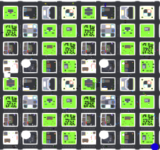
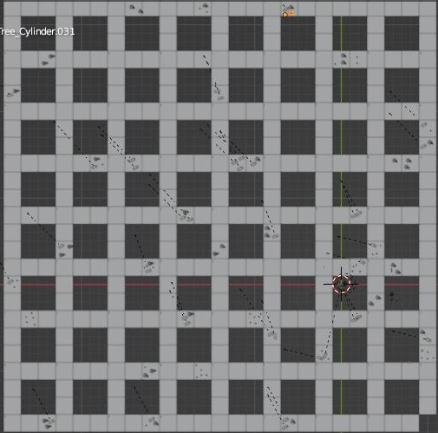
Levels
There are 6 level to complete game each level map will generated randomly and given time to player is decreasing

Slide 12
03
Algorithm

Slide 13
What CS Algorithm Used and How It Works?
We used “Uniform Cost Serach” algorithm.
Uniform-Cost Search is a variant of Dijikstra’s algorithm. Here, instead of inserting all vertices into a priority queue, we insert only source, then one by one insert when needed. In every step, we check if the item is already in priority queue (using visited array). If yes, we perform decrease key, else we insert it. Uniform-Cost Search is mainly used in Artificial Intelligence.
I used non biderctional UCS and on the map every road interseciton can goes right or left not back .
The player will positioned to start vertex which is 66 and on the map some road has several cars crach and tree or rocks ,etc. When player start game my algoritgim detect shortest path to given filter .

Slide 14
Algorithm implementation psuedocode
function UNIFORM-COST-SEARCH(problem) returns a solution, or failure if problem's initial state is a goal then return empty path to initial state frontier ← a priority queue ordered by pathCost, with a node for the initial state reached ← a table of {state: the best path that reached state}; initially empty solution ← failure while frontier is not empty and top(frontier) is cheaper than solution do parent ← pop(frontier) for child in successors(parent) do s ← child.state if s is not in reached or child is a cheaper path than reached[s] then reached[s] ← child add child to the frontier if child is a goal and is cheaper than solution then solution = child return solution

Slide 15
04
Camera Usage

Slide 16
There are two camera options for my project.
One is controlled by Mouse. You can rotate the camera while you are following the character. Mouse rotation works with activating the Third Person Control Properties of three.js.
Other Camera is orthogonal camera to create minimap for player

Slide 17
05
Models

Slide 18
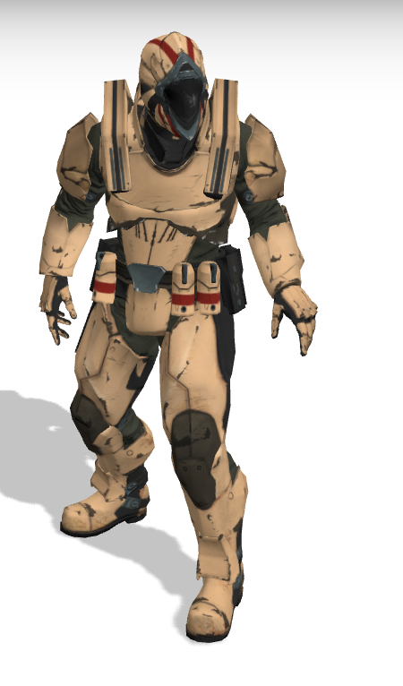
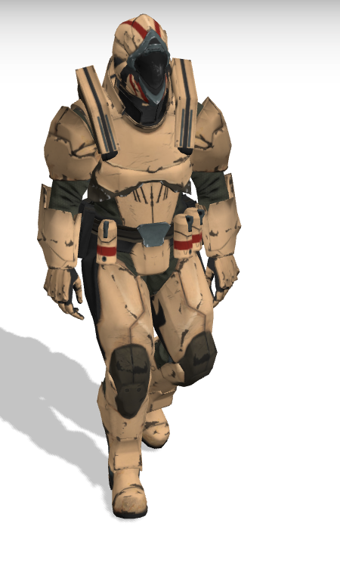
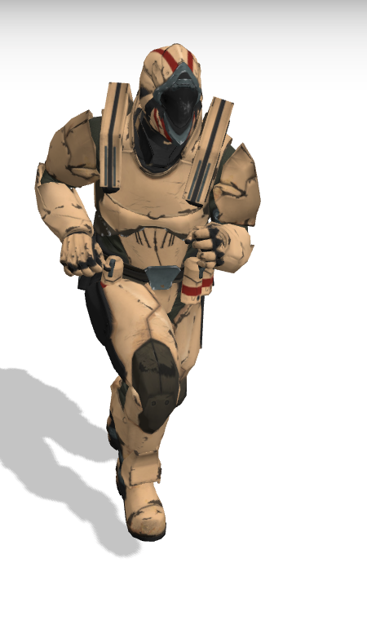
Character
I created my map using blender application and ı used some dummy object which is found by free3d objects and some useful web-sites .
I use default charcter from three.js
character link
Idle
walk
run

Slide 19
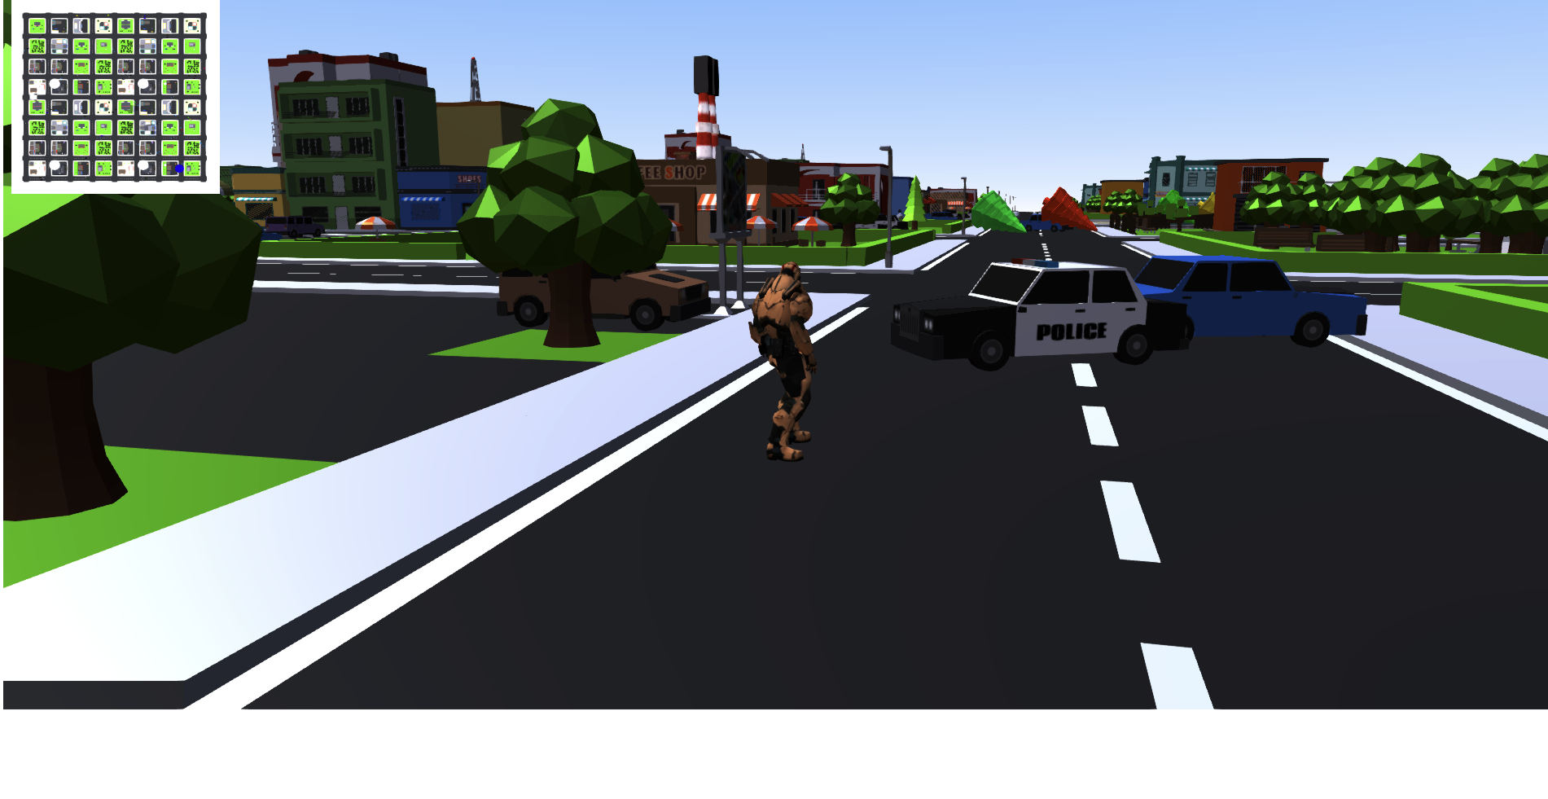
Map and Objects
Thre are so many objects to shown as you can see

Slide 20
06
References

Slide 21
References
3D models - https://www.blender.org/about/
Character - https://www.mixamo.com/#/
Music used in the game :https://www.epidemicsound.com/signup?next=%2Fsound-effects%2Ffootsteps%2F
UCS algorithm - https://algodaily.com/challenges/longest-increasing-subsequence
Implementation – https://threejs.org/examples/ - webgl_animation_keyframes
https://www.youtube.com/watch?v=8n_v1aJmLmc&ab_channel=SimonDev
https://threejs.org/examples/#webgl_lights_hemisphere
https://threejs.org/examples/#misc_controls_pointerlock
https://threejs.org/examples/misc_controls_drag

